Slide 1
USER ENGAGEMENT ANALYSIS FOR RESTAURANT SUCCESS

Slide 2
About Yelp
Yelp is a web and mobile platform that functions as a crowd-sourced local business review site. Users can submit review, photos, and tips about businesses, while also browsing information and rating left by others

Slide 3
Agenda
Problem Statement
Research Objectives
Hypothesis
Data Overview
Analysis and Findings
Recommendations

Slide 4
Problem Statement
In a competitive market like the restaurant industry, understanding the factors that influence business success is crucial for stakeholders. Utilizing the Yelp dataset, this project aims to investigate the relationship between user engagement (reviews ,tips and check-ins) and business success metrics (review count, ratings) for restaurants.

Slide 5
Data Overview
This dataset is a subset of Yelp and has information about businesses across 8 metropolitan areas in the USA and Canada.
The original data is shared by Yelp as JSON files.
The five JSON files are business, review, user, tip and check in.
The JSON files are stored in the database for easy retrieval of data.

Slide 6
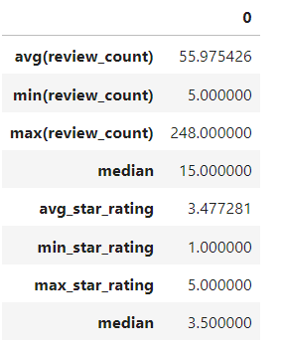
Analysis and Findings
Out of 150k Business, 35k are restaurants business and are open.
Table showing distribution of business success metrics (review count and average rating):

Slide 7
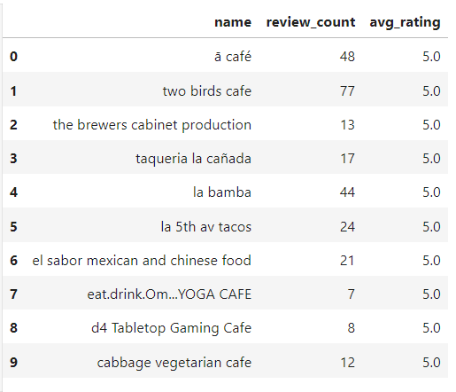
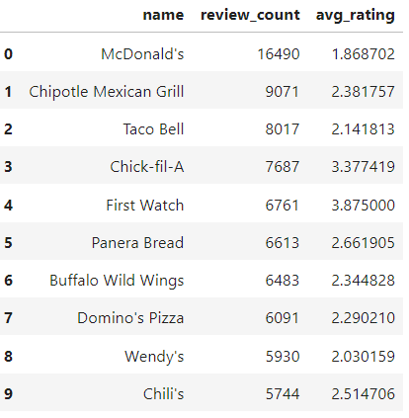
Highest Rating
Highest Review Count
Higher ratings do not guarantee a higher review count, or vice versa.
Success of a restaurants is not solely determined by ratings or review counts.
Review count reflects user engagement but not necessarily overall customer satisfaction or business performance.

Slide 8
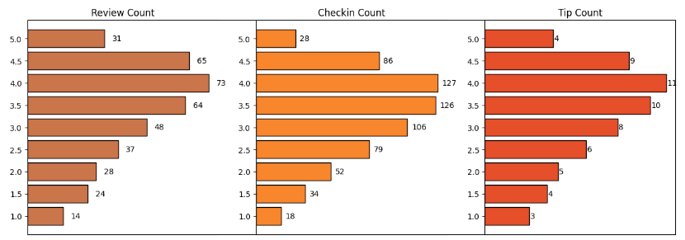
Do restaurants with higher engagement tend to have higher ratings?
Data shows a general increase in average review, check-in, and tip counts as rating improve from1 to 4 stars.
Restaurants rated 4 stars exhibit the highest engagement and shows a downward trend for rating above 4.
The drop in engagement at 5.0 stars might suggest either a saturation point where fewer customers feel compelled to add their reviews, or a selectivity where only a small, satisfied audience frequents these establishments.

Slide 9
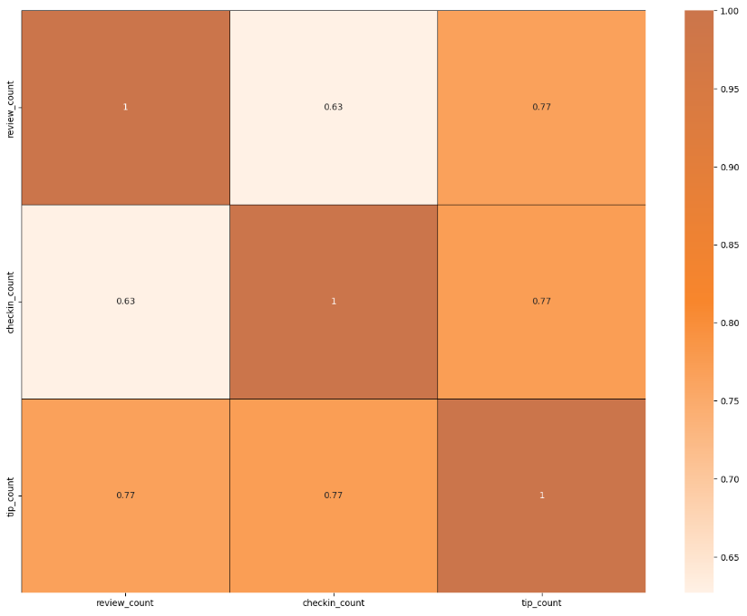
Is there a correlation between the number of reviews, tips, and check-ins for a business
These correlation suggest that user engagement across different platforms is interlinked; higher activity in one area tends to be associated with higher activity in others.
Business should focus on strategies that boost all types of user engagement, as increase in one type of engagement are likely to drive increase in others, enhancing overall visibility and interaction with customers.

Slide 10
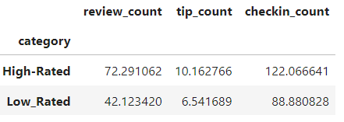
Is there a difference in the user engagement between high-rated and low-rated businesses?
Data indicates a clear correlation between higher ratings and increased user engagement across reviews, tips, and check-ins.
This pattern underscores the importance of maintaining high service and quality standards, as these appear to drive more reviews, check-ins, and tips, which are critical measures of customer engagement and satisfaction.

Slide 11
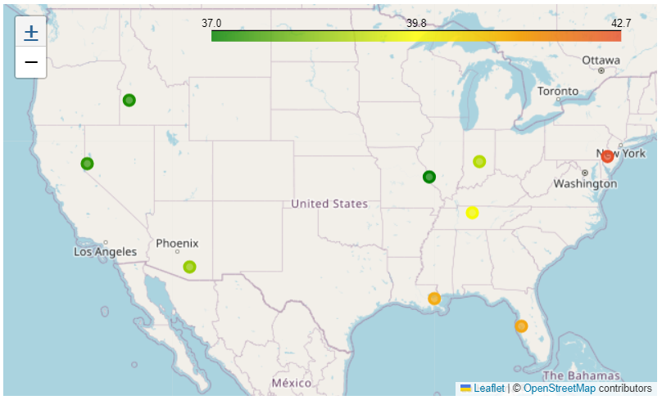
How do the success metrics of restaurants vary across different states and cities?
Philadelphia emerges as the top city with the highest success score, indicating a combination of high ratings and active user engagements.
Following Philadelphia, Tampa, Indianapolis and Tucson rank among the top cities with significant success scores, suggesting thriving restaurant scenes in these areas.

Slide 12
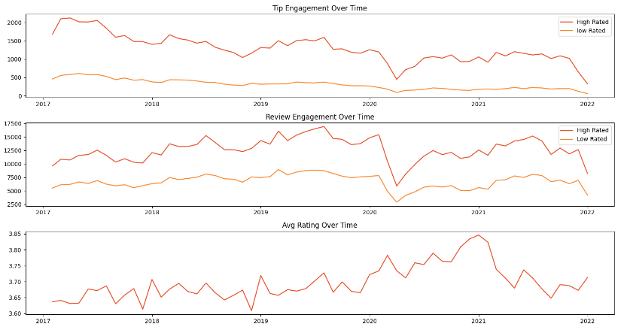
Are there any patterns in user engagement over time for successful businesses compared to less successful ones?
Successful businesses particularly those with higher ratings ( above 3.5), exhibit consistent and possibly increasing user engagement over time.
High rated restaurants maintain a steady or growing level of user engagement over time, reflecting ongoing customer interest and satisfaction.

Slide 13
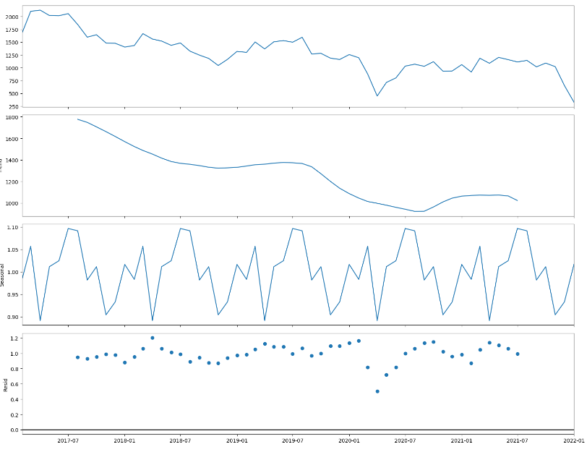
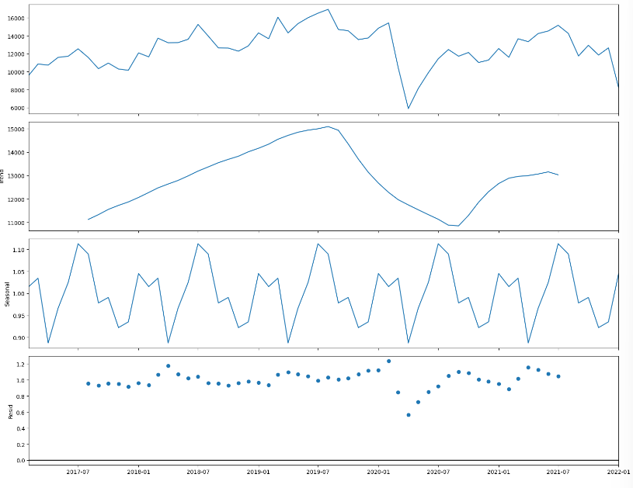
Trend and Seasonality Analysis
Tip Count
Review Count

Slide 14
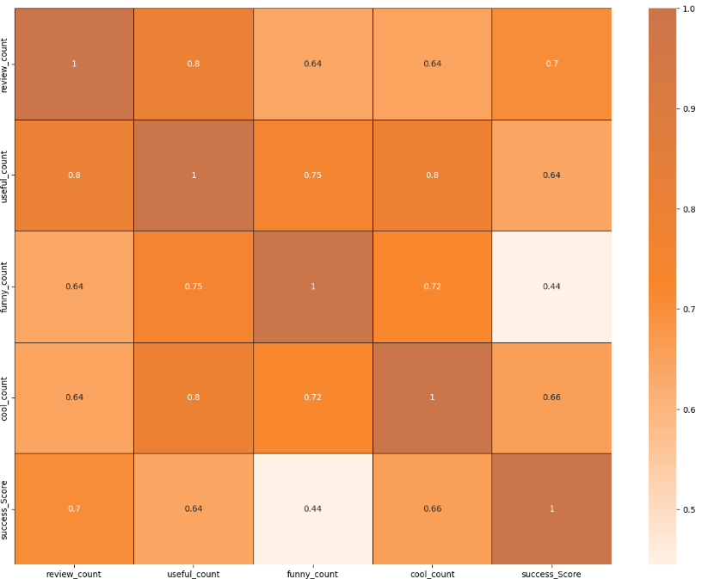
How does the sentiment of review and tips correlate with the success metrics of restaurants
‘useful’, ‘funny’ and ‘cool’ are attributes associated with user reviews. They represent the feedback provided by user about the usefulness, humor, or coolness of a particular review.
Higher counts of useful, funny, and cool reviews suggest greater user engagement and satisfaction, which are key factors contributing to a restaurant’s success.

Slide 15
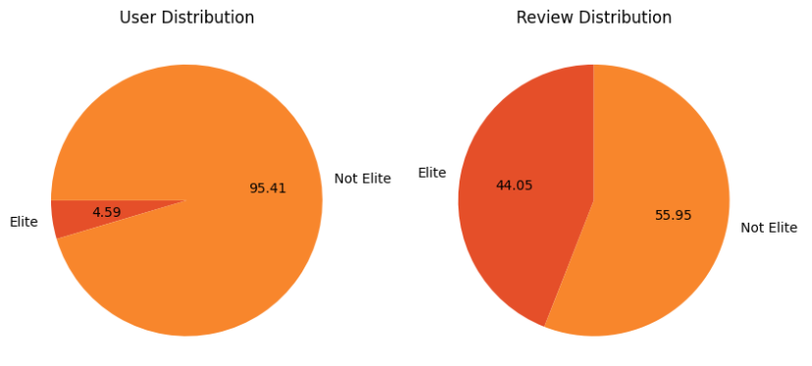
Is there any difference in engagement of elite users and non elite users?
Elite users are individuals who have been recognized and awarded the “Elite” status by Yelp for their active and high-quality contributions.
Elite users, despite being significantly fewer in number, contribute a substantial proportion of their total review count compared to non-elite users.

Slide 16
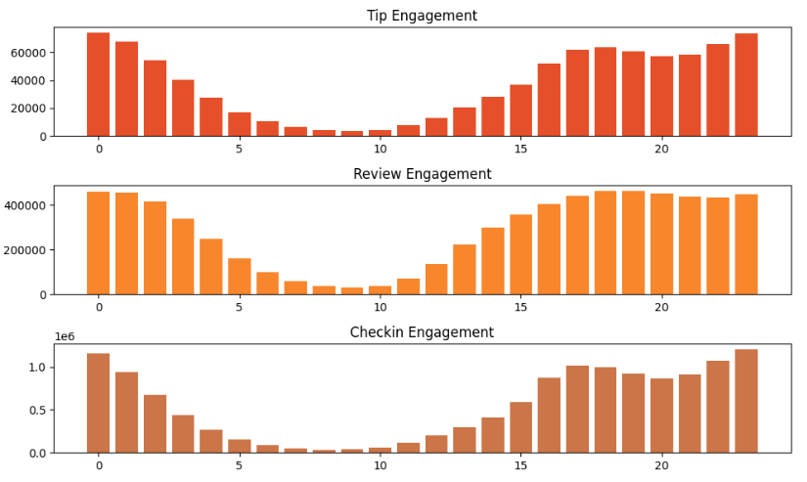
Busiest Hours
The busiest hours for restaurants, based on user engagement, span from 4pm to 1am.
Knowing the peak hours allows businesses to optimize their staffing levels and resource allocation during these times to ensure efficient operations and quality service delivery.
The concentration of user engagement during the evening and night hours suggests a higher demand for dining out during these times, potentially driven by factors such as work schedules, social gatherings and leisure activities.

Slide 17
THANK YOU

